Slide 1


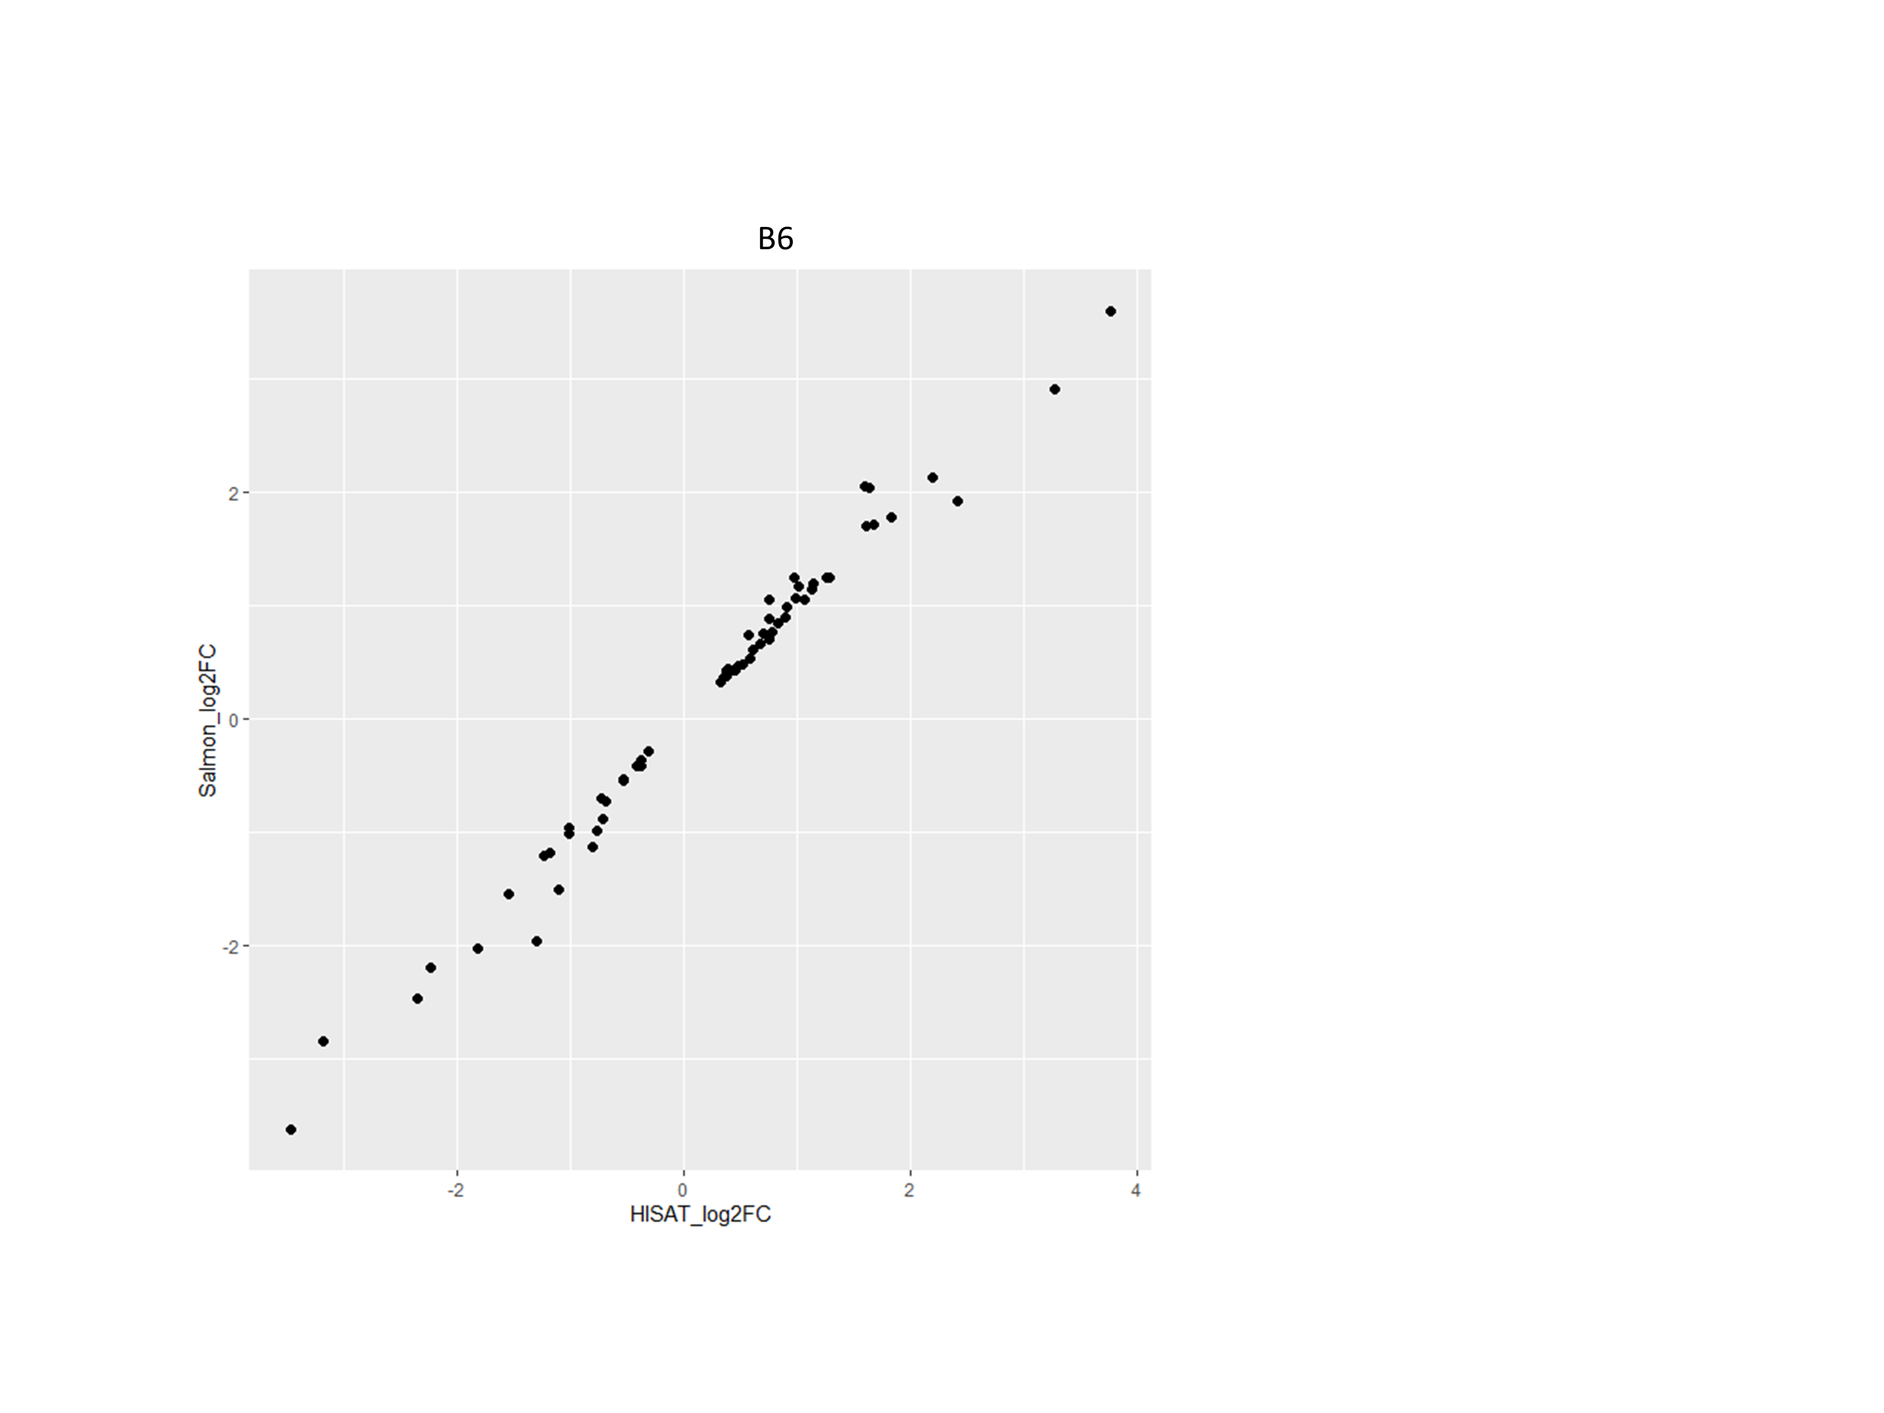
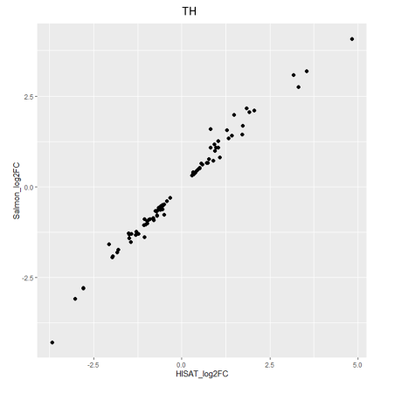
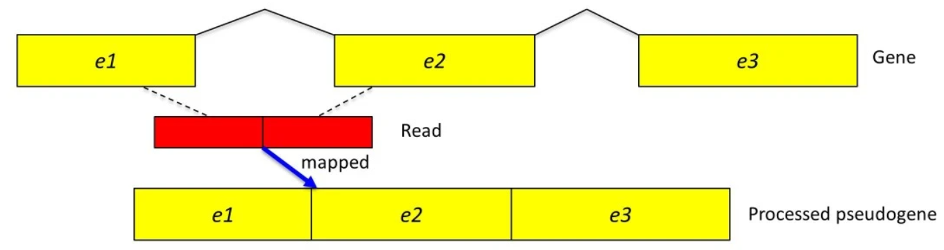
Comparing Alignment-based Methods to Alignment-free Methods of RNAseq Sample Quantification.
Syed Monis Ali [1*], Chandler Russell [1*], Jung-Han Kim [2], James Denvir [2†], Nicole Garrison [3†]. [1] Department of Arts and Science, Bluefield State College; [2] Department of Biomedical Sciences, Marshall University; [3] Department of Biomedical Sciences, West Liberty University.
Background
Materials and Methods I
Figure 3: Scatterplot comparing HISAT2 and SALMON log data:
We are comparing the effectivity of the HISAT2 function (Alignment based method) and Salmon function (Alignment-free methods). Both methods are part of Next generation sequencing (NGS). Next generation sequencing gives researchers a platform to simultaneously sequence reactions with high throughput (working on millions of sequence at the same time). HISAT2 and SALMON are few of the tools that have developed, and we will compare them regarding their activity and quality of data they produce.
Files were first converted from their raw form i.e., Fasta files to Fastq format and additional quality checks were done before the faulty codes were trimmed. For trimming, we used the Trinity feature from Ubuntu shell, which gave us compressed files. At this point we also divided our genome into paired and unpaired format which means the
HISAT2
Introduction
HISAT2 is an alignment base method splice the function into 25 nucleotides and then align it to the reference genome. The targeted nucleotides are aligned to exons, and it assumes that the reads come from splicing of the exons on the reference genome. So, we expect to find big gaps between reads. HISAT process the fastq files and output bam files. These reads can be viewed in IGV.
Bioinformatics is a relatively new form of assessing Biological information digitally where we can view the information of DNA/RNA computers help. RNA. RNA seq through computer is an essential step in quantitative analysis when it comes to studying the transcriptome. In RNA-Seq we need to count the number of sequencing reads that originate from each gene (or transcript). We can align reads directly to the reference genome and count the number of reads that map to each gene or transcript. Alternatively, there are quantification-based methods that rely on indexing each transcript sequence and match reads to transcripts based on that index. This project will compare the two methods using a collection of mouse RNA-Seq samples to see if there are differences in the read count tables and in the identification of differentially-expressed genes.
Figure 3: shows the plotted data which represents the change in the gene expression from both mouse models which went through each pipeline of HISAT and SALMON.
Figure 1: HISTA2 Reading Method:
Figure 4: Scatterplot comparing Each sample through HISAT2 and SALMON:
Figure 4: HISAT2 and Salmon both generated a count table at the end of their pipelines. We put these count tables into R studios to generate 14 different tables, one for each sample. Graphs were also then made comparing the log –p values resulting from putting the two diet’s data through each pipeline
Pathway
Figure 1: Represents the hypothetical model of the function. We can expect gaps between each gene as the reads may come from spliced exons (figure adapted from Kim et al., Genome Biology 2013)
Fastqs files
SALMON
Salmon is an alignment free method which references files to a transcriptome, rather than a genome reference as HISAT2 works. Salmon is made for the quantifying expression of transcripts using RNAseq data. It promises data processing in less time while using less memory as compared to HISAT2.
Alignment (HISAT2)
Quantification (Salmon)
DESeq2 and R
DESeq2 provides a collapse replicate function where it puts together a table from different technical replicates to a single column of matrix. It is used to define the differences in multiple biological genome. We used R because of its flexible statistical environment which lets us puts together the data (after some modification) taken from DESeq2 and display it into graph.
Count Table
Count Table
Discussion
When it came to which program yielded the better data results, both stayed relatively close to the middle of the line of best fit. In each case however, there were genes that were above this line (upregulated) and ones that styed below the line(downregulated). It is also worth noting that there was originally 15 data samples but due to corruption of one file in the HISAT2 dataset, Corrupted dataset for both sides was ignored.
DESeq2,
Results
Figure 2: Up regulation comparison between TH and B6:
Differentially Expressed Genes
TH
B6
277 unique genes
162 Unique genes
474 unique genes
60 Unique genes
Conclusion
HISAT
Salmon
HISAT
Salmon
In conclusion, Depending on which gene is being experimented with, either HISAT2, salmon, or both could be used for bioinformatical purposes. We noticed higher up regulation when we used alignment-based method (HISAT2) while number of genes were still upregulated in the Salmon. The key in future cases will be determining why genes upregulation is different in both programs, and what would be the best deciding factor in what program to use.
R
372 genes overlap
64 genes overlap
Comparison scatterplots
Acknowledgment
Figure 2: TH=Tallyho (Diabetic model), B6=Black6 (wildtype) mouse diabetic model. HISAT overall compares up regulated genes
Figure 1:Kim et al., Genome Biology 2013
Supported by NIH Grant P20GM103434 to the West Virginia IDeA Network for Biomedical Research Excellence

